Slide 1
PROBLEM STATEMENT
Protecting User Password Keys at Rest (on the Disk).

Slide 2
Unique Idea Brief (Solution)
Master Key Encryption: Implementing a master key encryption scheme ensures that the user-derived encryption keys are themselves encrypted with a stronger, centrally managed key. This approach enhances security by protecting user keys at rest, ensuring they are not exposed even if the encrypted data is compromised.
Secure Key Derivation: Utilizing a strong key derivation function (KDF) like PBKDF2 with sufficient iterations and a unique salt per user strengthens the security of derived keys. This ensures that passwords are not directly used for encryption but are instead transformed into keys that are computationally intensive to reverse-engineer.
Integrated User Interaction: Incorporating user prompts for password input during encryption and decryption enhances user awareness and involvement in the security process. This ensures that passwords are not stored or transmitted in plain text, maintaining confidentiality throughout the encryption lifecycle.

Slide 3
Features Offered
File Selection
Password Protection
Encryption
Decryption
Secure Key Handling
Master Key Encryption
Error Handling
User Interface
Feedback Messages

Slide 4
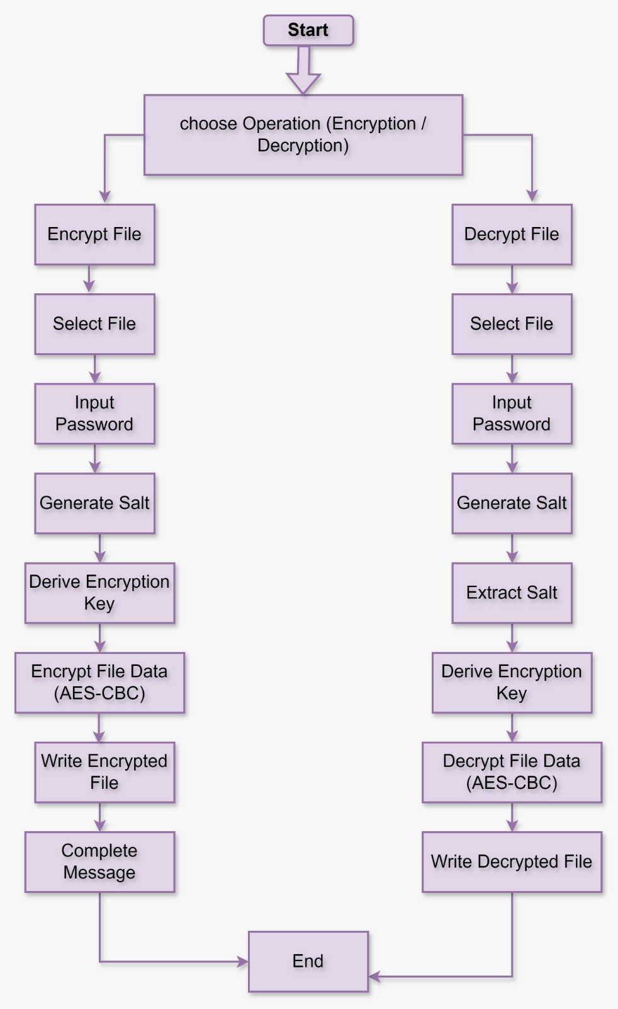
Process Flow

Slide 5
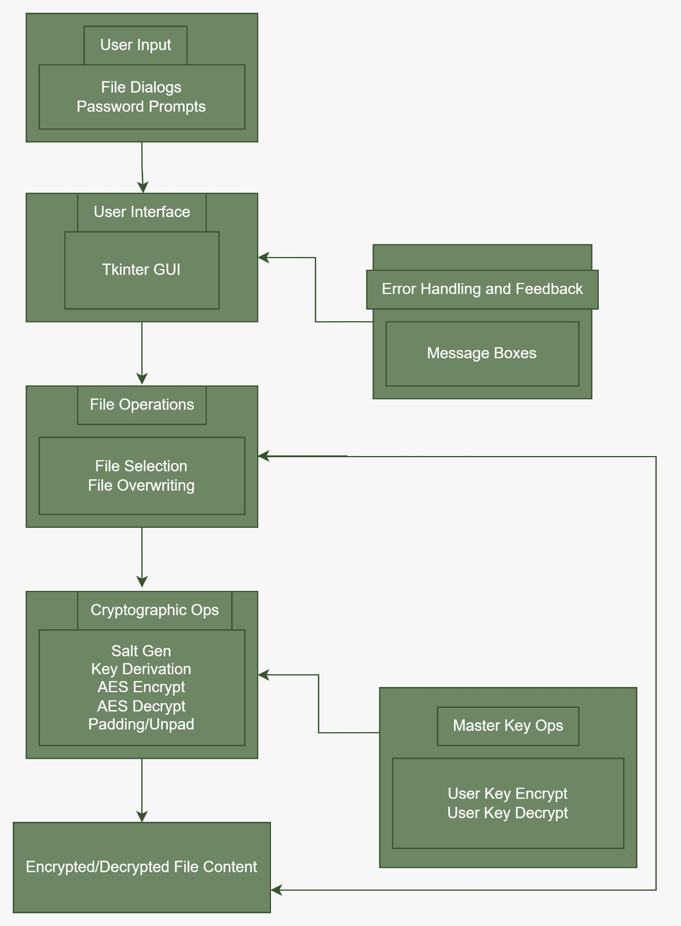
Architectural Diagram

Slide 6
Technologies Used
Python
Tkinter
tk.Tk(): Main window creation.
tk.Label: Labels for text display.
tk.Button: Buttons for user actions (encrypt/decrypt).
filedialog.askopenfilename(): Dialog for file selection.
simpledialog.askstring(): Prompt for password input.
messagebox.showinfo() / messagebox.showerror(): Dialogs for user feedback.

Slide 7
Cryptography
PBKDF2HMAC: Derives a cryptographic key from a password and salt.
SHA256: Hash function used in key derivation.
default_backend: Provides cryptographic backend.
Cipher, algorithms.AES, modes.CBC: Used for AES encryption/decryption in CBC mode.
padding.PKCS7: Ensures plaintext is padded to the correct block size for AES.
os
os.urandom()

Slide 8
Team Members and Contribution
We all three members, worked together in building this project on protecting user keys at rest by utilizing several resources and tools to ensure robust security and efficient performance.
All of us equally contributed in making the ppt, report and the coding part.

Slide 9
Conclusion
In conclusion, our project successfully addressed the critical need for protecting user keys at rest by implementing robust security measures and utilizing advanced tools and resources. Through our collaborative efforts, we were able to design and develop a comprehensive solution that ensures the confidentiality and integrity of user keys, mitigating potential risks and vulnerabilities. This project not only demonstrates the effectiveness of our approach but also sets a foundation for future enhancements and applications in secure key management systems."

